Slide 1
YO (OBLIGATORIO) | PADRE/ MADRE | HERMANO/ HERMANA | ABUELO/ ABUELA | PRIMO/ PRIMA | TÍO/TÍA
Describe yourself -use two different physical characteristics | Describe them -use two different physical characteristics | Describe them -use two different physical characteristics | Describe them -use two different physical characteristics | Describe them -use two different physical characteristics | Describe them -use two different physical characteristics
Describe yourself -use two different personality characteristics | Describe them -use two different personality characteristics | Describe them -use two different personality characteristics | Describe them -use two different personality characteristics | Describe them -use two different personality characteristics | Describe them -use two different personality characteristics
Say where you are from | Say where he/she is from | Say where he/she is from | Say where he/she is from | Say where he/she is from | Say where he/she is from
You will describe yourself and one other family member from above.
You present 2 people total. You choose the 2nd person.
Use 4 different adjectives→ DO NOT REPEAT
I can ask and talk about family members and their characteristics.
What is your (family member) like?
My (family member) is (physical characteristics) and (personality characteristics)

Slide 2





Luisa (Ecuador) | Leonor (PR) | Sofia (Canada) | Miguel (Italy) | Rafa (Mexico)
Where is ______ from? | Where is ______ from? | Where is ______ from? | Where is ______ from? | Where is ______ from?
_____ is from _____. | _____ is from _____. | _____ is from _____. | _____ is from _____. | _____ is from _____.
She is __________. | She is __________. | She is __________. | He is __________. | He is __________.
I will point to one name.
You will say 3 things:
You will 1. ask “Where is [name] from?”
You will 2. answer “[name] is from [country].”
You will 3. say “[name] is [nationality].”
I can ask and say someone’s nationality.
From where is _______?
_____ is from France.
He is French.

Slide 3





Luisa | Leonor | Sofia | Miguel | Rafa
I will ask you “Whose [object] is it?”
You will say: “It is [name]’s [object]”.
You will say: “It is his/her [object]”.
I can express ownership.
Look at a picture.
The book is his.
The backpack is Ana’s.
It is my house.

Slide 4




¿Qué hora es?

Slide 5


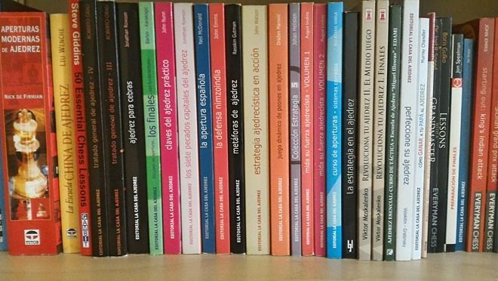
¿Cuántos libros hay?
8
17
31

Slide 6





I can answer questions about what I like and dislike. (We will use the verb GUSTAR)
What do you like?
What do you not like?
I will ask you what you like to do and what you don’t like to do. Both activities must be based on 2 different images from this page.

Slide 7
¿Cuándo…?
¿Por qué…?
¿Quién/
Quiénes…?
¿Cómo…?
¿Cuánto…/
Cuántos…?
¿Qué…?
¿Cuál…?
¿Dónde…?
¿De dónde…?
¿Adónde…?
I can answer who, what, when, where questions.
Por ejemplo:
-Who is your math teacher?
-Where is your house?
- What do you study?
I will ask you 3 questions. Answer each one with a complete sentence. (verb + rest of the answer)

Slide 8
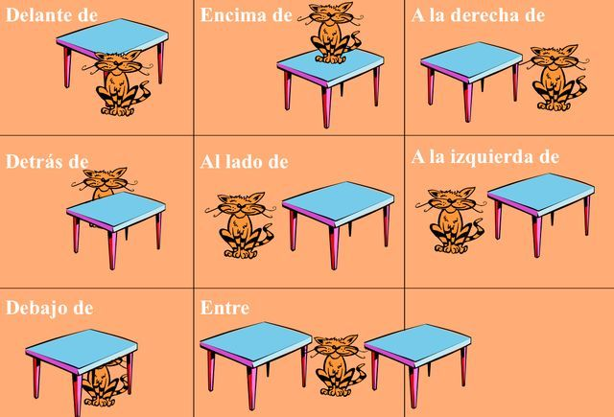
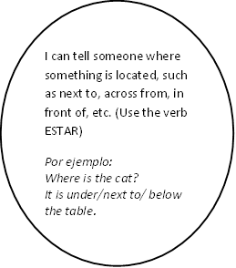
EL GATO
EL GATO
EL GATO
EL GATO
EL GATO
EL GATO
EL GATO
EL GATO
I will point to 2 pictures. You will use the verb “estar” and a preposition to tell me where the cat is.

Slide 9
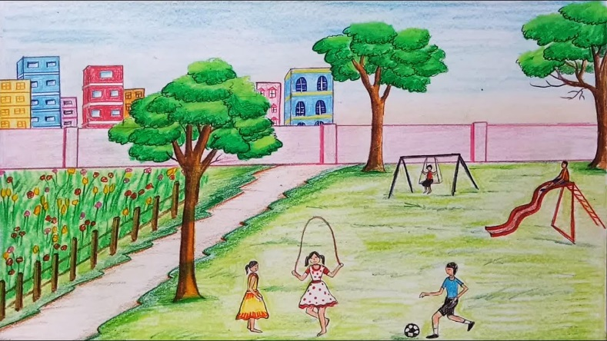
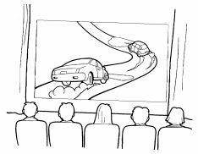

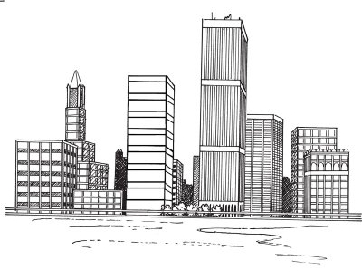
I can answer who, what, when, where questions about places.
Por ejemplo:
-Where are you going?
- What are you going to do?
I will ask you 2 questions. Answer each one with a complete sentence. (verb + rest of the answer)

Slide 10
1) You will ask me: When is your birthday?
2) I will answer and ask: and you?
3) You will answer: My birthday is the [#] of [month].
4) You will ask me: How old are you?
5) I will answer and ask: and you?
EL FIN
I can ask who, what, when, where questions.
You will ask and answer questions about birthdays and ages.
I can ask who, what, when, where questions.
You will ask and answer questions about birthdays and ages.

