Slide 1
Today during Nest
We are going to take the opportunity to do some housekeeping to ensure good communication between teachers & students

Slide 2
Students need to complete 5 tasks today during Nest:
Verify or add a valid student email into Skyward. @issaquah.wednet.edu emails DO NOT WORK. Don’t have one? Create a gmail or Hotmail email quickly and add it. Note your password.
Email yourself the links to all 7 of your teachers’ websites so you have them handy to access quickly in your email
Verify you can log in to classlink & turnitin.com & AP Classroom (if applicable)
Make sure you are signed up for Remind.com texts
Take a survey

Slide 3
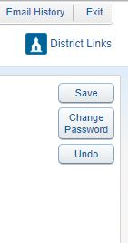
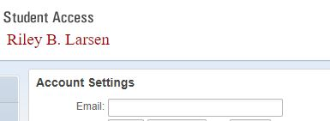
Student email in Skyward
Please make sure you have a valid email address listed in Skyward for all of your teachers to use. You need to know the password and be able to get emails regularly. Note - @Issaquah.wednet.edu email address are not valid for students
STEPS:
Log in to student access
At the top click My Account
Fill in the email box with the correct
email address
4. Click save

Slide 4
Email yourself your teachers’ websites
Please locate your 7 teachers’ websites and email the links to yourself.
EITHER…
Send 7 emails with the period/course in the subject line
Send 1 email with all 7 periods in the body of the mail

Slide 5
2 major logins and 1 possible:
Log in to https://launchpad.classlink.com/Issaquah and make sure you can log in. The username and password are the SAME as the ones you use to log in to computers at Issaquah High
Log in to turnitin.com (your log in and password are unique to you)
IF you are in an AP Class, also log in to AP Classroom (your log in and password are unique to you)

Slide 6
Sign up for Remind.com text messages
A test TEXT was sent today during 6th period to students who are ALREADY SIGNED UP for remind.com texts
IF you did not receive the test, please sign up today based on your grade level:
9th GRADE | 10th GRADE | 11th GRADE | 12th GRADE
TEXT @hgggg9f To 81010 | TEXT @h3ehfg4 To 81010 | TEXT @48bg7bf To 81010 | TEXT @ihs789 To 81010

Slide 7
Survey
Please take 5 minutes to complete the survey below:
https://tinyurl.com/txbaamc

